Slide 1
NYC 2014-17 Collision Analysis
Prepared by Raoul Fernandes

Slide 2
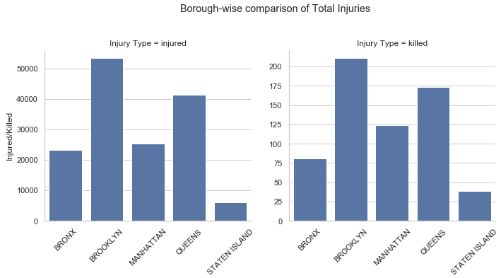
Executive Summary
Compared to other boroughs in NYC; Brooklyn ranks the highest for overall number of collisions and severity of collisions from 2014-17
Causes of collisions range from driver-related to dated infrastructure and lack of signage for on-road motorists
The severity of the collisions have decreased since 2015; however improvements to the infrastructure could prompt a further decrease in the number of collisions

Slide 3
Analysis Approach
Exploratory Data Analysis
Borough-Wise comparison
A detailed borough-wise comparison of collisions and fatality rates to gauge the best and worst performing boroughs
Segmentation of collisions by commuter type (cyclists, motorists, pedestrians) to identify underlying trends in collision rates
Time-Series Analysis
Understanding collision trends
Identifying collision patterns across the different boroughs over years, months and time of day
Possible correlation between time of day and number of collisions point to further analysis for location based mapping and analysis
Insights and Causations
Identifying causes and issues
Identifying causes for high collision rates based on recorded data by emergency responding personnel
No solid relation found between the number of collisions and vehicle type which could point to certain underlying causes
Limitations and Future Work:
Location data in the data set is based on the nearest street and cross-street information recorded by emergency personnel. It does not represent the true location of collision
Merging the existing data set with weather data would enable further analysis into the impact of the weather on a given day on the number of collisions

Slide 4
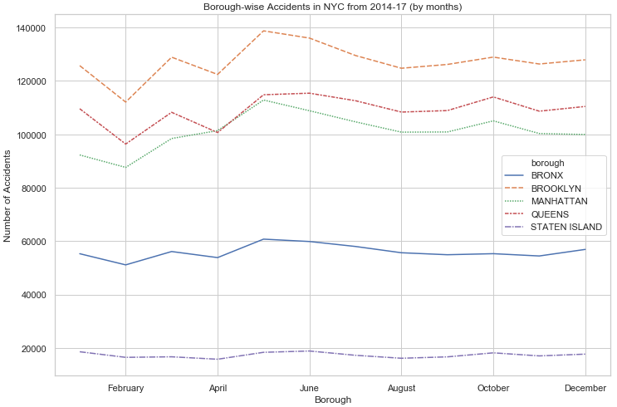
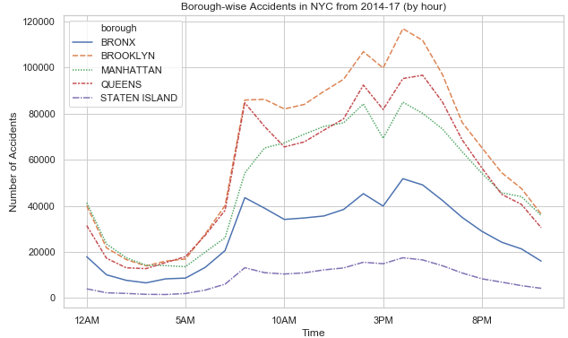
Insights and Findings
Month-wise comparison of collision rates are point to an increase in the months of March and May while relatively fewer collisions in the summer/fall months
This trend can be attributed to the weather cycle which would impact visibility and road traction
Hour-wise comparison of collision rates are in-line with weekly rush-hour times with collision rates reaching a high from 7am-9am and 4pm-6pm
Slight increased during the working day point to collisions caused by delivery trucks and other vans

Slide 5
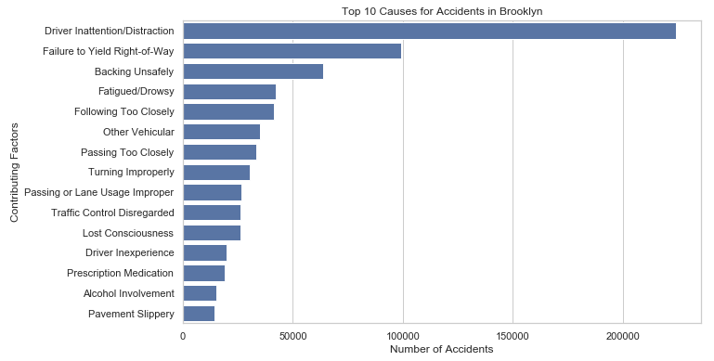
Insights and Findings
A large number of collisions do not have a reason associated to them in the data set; as such they have been filtered out
Some of the top reasons for collisions are driver-related such as driver distraction, failure to yield, backing unsafely etc.
Some reasons are infrastructure related such as slippery pavement and passing or lane usage improper

Slide 6
Recommendations & Takeaways
Increased deployment of traffic rule awareness programs on importance of concentrating on the road and being focused, and strict actions on violations to increase motorists attention while driving
Stricter enforcement of actions on violations of driving under the influence of alcohol and prescription medications
Improvement in infrastructure and signage to help guide motorists for turning and clearly visible speed limits and lane markings for bicyclists and vehicles
Clear signs and timers posted on street-crossing for pedestrians
Addition of reflectors and reflecting paint to help motorists during low visibility days and evenings

